Slide 1
SQL Server Statistics Structure
Module 6

Slide 3
Learning Units covered in this Module
Lesson 1: SQL Server Statistics Internals
Lesson 2: SQL Server Statistics Maintenance

Slide 4
Lesson 1: SQL Server Statistics Internals

Slide 5

Objectives
After completing this learning, you will be able to:
Understand statistics, and to retrieve their contents.
Review database options used to control statistics creation and update.
Use different methods to read statistics information.

Slide 6
SQL Server statistics
What are the statistics?
Statistics contain statistical information about distribution of values in one or more columns of a table or index.
It is stored as binary large objects (BLOBs).
It is used by the Query Optimizer (QO) to estimate the cardinality, or number of rows, in the query result, and enable the creation of high-quality query plans.
Statistics are created:
Intrinsically when indexes are created.
Manually by using CREATE STATISTICS command.
Automatically, to support WHERE clauses (if AUTO_CREATE_STATISTICS in ON).
Notes:
https://docs.microsoft.com/en-us/sql/relational-databases/statistics/statistics

Slide 7
Statistics components
Density Vector
Density is information about the number of duplicates in each column or combination of columns
Histogram
A histogram measures the frequency of occurrence for each distinct value in a data set.
Used when query predicate contains variable WHERE col = @variable or when a stored procedure uses query on a modified parameter: WHERE col = @local_variable
Used when query predicate contains WHERE col = ‘literal’ or when a stored procedure uses a query on a parameter WHERE col = @parameter
Notes:
Density Vector:
It is calculated as 1/(number of distinct values).
The query optimizer uses densities to enhance cardinality estimates for queries that return multiple columns from the same table or indexed view. As density decreases, selectivity of a value increases.
Histogram:
Histograms in SQL Server are only built for a single column-the first column in the set of key columns of the statistics object.
https://docs.microsoft.com/en-us/sql/relational-databases/statistics/statistics

Slide 8
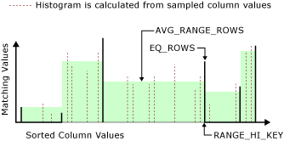
Statistics components
Histogram
It is computed from the values in the leftmost key column of the statistics object.
Data is selected from table or view in one of two ways:
Statistically sampling rows. Data shown contains estimates of rows and distinct values.
Performing a full scan of all rows. Data shown contains actual numbers.
Notes:
For further information refer to:
https://docs.microsoft.com/en-us/sql/t-sql/database-console-commands/dbcc-show-statistics-transact-sql
https://docs.microsoft.com/en-us/sql/relational-databases/statistics/statistics

Slide 9
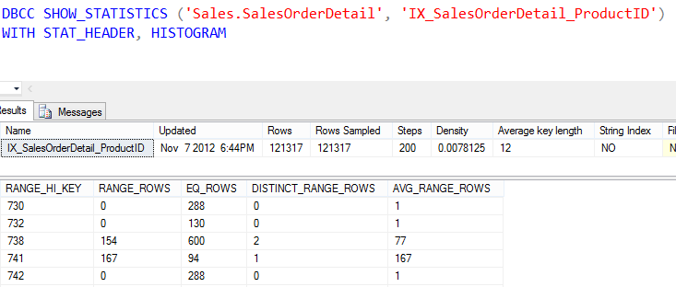
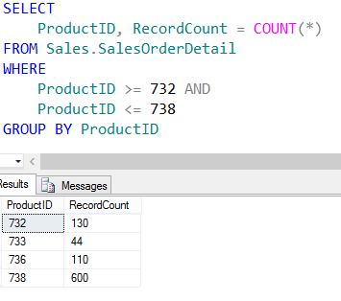
Showing Statistics

Slide 10
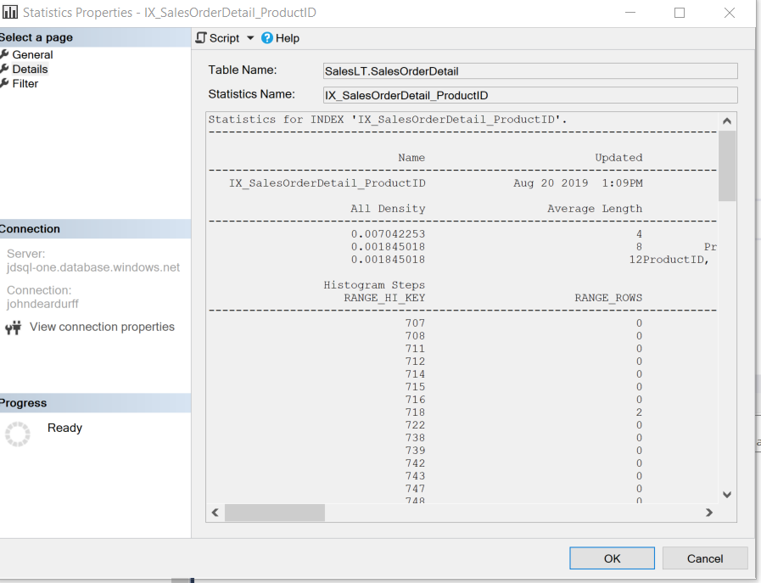
Showing Statistics

Slide 11
Automatically created statistics
Database options that affects automatic statistics creation and update
AUTO_CREATE_STATISTICS
AUTO_UPDATE_STATISTICS_ASYNC
AUTO_UPDATE_STATISTICS
INCREMENTAL
Use the defaults unless you NEED to do otherwise.
Do not enable auto-create statistics on SharePoint content database.
The small sample rate of AUTO_UPDATE_STATISTICS can cause some workloads to choose sub-optimal execution plans.
Notes:
AUTO_CREATE_STATISTICS { ON | OFF }
ON Query Optimizer creates statistics on single columns in query predicates, as necessary, to improve query plans and query performance. These single-column statistics are created when Query Optimizer compiles queries. The single-column statistics are created only on columns that aren't already the first column of an existing statistics object.
The default setting is ON. We recommend that you use the default setting for most databases.
OFF Query Optimizer doesn't create statistics on single columns in query predicates when it's compiling queries. Setting this option to OFF can cause suboptimal query plans and degraded query performance.
You can determine this option's status by examining the is_auto_create_stats_on column in the sys.databases catalog view. You can also determine the status by examining the IsAutoCreateStatistics property of the DATABASEPROPERTYEX function.
For more information, see the section "Using the Database-wide statistics options" in Statistics.
INCREMENTAL = ON | OFF
Set AUTO_CREATE_STATISTICS to ON, and set INCREMENTAL to ON. This sets automatically created stats as incremental whenever incremental stats are supported. The default value is OFF. For more information, see CREATE STATISTICS.
AUTO_UPDATE_STATISTICS { ON | OFF }
ON Specifies that Query Optimizer updates statistics when they're used by a query and when they might be out-of-date. Statistics become out-of-date after insert, update, delete, or merge operations change the data distribution in the table or indexed view. Query Optimizer determines when statistics might be out-of-date by counting the number of data modifications since the last statistics update and comparing the number of modifications to a threshold. The threshold is based on the number of rows in the table or indexed view.
Query Optimizer checks for out-of-date statistics before it compiles a query and runs a cached query plan. Query Optimizer uses the columns, tables, and indexed views in the query predicate to determine which statistics might be out-of-date. Query Optimizer determines this information before it compiles a query. Before running a cached query plan, the Database Engine verifies that the query plan references up-to-date statistics.
The AUTO_UPDATE_STATISTICS option applies to statistics created for indexes, single-columns in query predicates, and statistics that are created by using the CREATE STATISTICS statement. This option also applies to filtered statistics.
The default is ON. We recommend that you use the default setting for most databases.
AUTO_UPDATE_STATISTICS_ASYNC
Use the AUTO_UPDATE_STATISTICS_ASYNC option to specify whether the statistics are updated synchronously or asynchronously.
OFF Specifies that Query Optimizer doesn't update statistics when they're used by a query. Query Optimizer also doesn't update statistics when they might be out-of-date. Setting this option to OFF can cause suboptimal query plans and degraded query performance.
You can determine this option's status by examining the is_auto_update_stats_on column in the sys.databases catalog view. You can also determine the status by examining the IsAutoUpdateStatistics property of the DATABASEPROPERTYEX function.
For further information refer to:
https://docs.microsoft.com/en-us/sql/t-sql/statements/alter-database-transact-sql-set-options
https://docs.microsoft.com/en-us/sharepoint/administration/best-practices-for-sql-server-in-a-sharepoint-server-farm

Slide 12
Manually created Statistics
For most queries, the query optimizer generates necessary statistics for a high-quality query plan.
In a few cases, additional statistics is needed to improve query performance.
CREATE STATISTICS ContactPromotion1
ON Person.Person (BusinessEntityID, LastName, EmailPromotion)
Notes:
For further information refer to:
https://docs.microsoft.com/en-us/sql/t-sql/statements/create-statistics-transact-sql

Slide 13
Filtered Statistics
May help address statistics quality issues for large tables with uneven data distributions.
Update threshold on filtered statistics is based on overall table threshold and not the filter predicate.
Filtered Statistics will not be used when RECOMPILE hint is missing.
CREATE STATISTICS ContactPromotion1
ON Person.Person (BusinessEntityID, LastName, EmailPromotion)
WHERE EmailPromotion = 2
Notes:
For further information refer to:
https://docs.microsoft.com/en-us/sql/t-sql/statements/create-statistics-transact-sql
https://channel9.msdn.com/Series/SQL-Workshops/Filtered-Statistics-in-SQL-Server

Slide 14
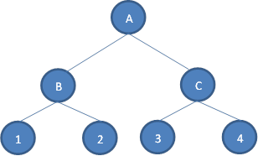
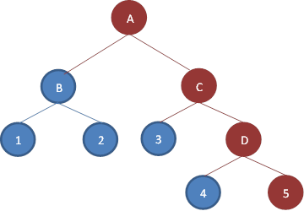
Incremental statistics
Introduced in SQL Server 2014.
The incremental option creates and stores statistics on a per partition basis.
It allows to update statistics for a single partition. reducing maintenance times and eliminating the need to scan all partitions to get data to calculate statistics.
Per-Partition Statistics are not available for query optimization and the cardinality estimator still uses global table stats for query optimization.
Partition level statistics are merged into a global statistic.
Create Incremental Statistics on a four partition table
Add partition 5 and
update statistics
Notes:
INCREMENTAL
When INCREMENTAL option of CREATE STATISTICS is ON, the statistics created are per partition statistics. When OFF, the statistics tree is dropped and SQL Server re-computes the statistics. The default is OFF. This setting overrides the database level INCREMENTAL property. For more information about creating incremental statistics, see CREATE STATISTICS (Transact-SQL). For more information about creating per partition statistics automatically, see Database Properties (Options Page) and ALTER DATABASE SET Options (Transact-SQL).
When new partitions are added to a large table, statistics should be updated to include the new partitions. However the time required to scan the entire table (FULLSCAN or SAMPLE option) might be quite long. Also, scanning the entire table isn't necessary because only the statistics on the new partitions might be needed. The incremental option creates and stores statistics on a per partition basis, and when updated, only refreshes statistics on those partitions that need new statistics.
If per partition statistics are not supported the option is ignored and a warning is generated. Incremental stats are not supported for following statistics types:
Statistics created with indexes that are not partition-aligned with the base table.
Statistics created on Always On readable secondary databases.
Statistics created on read-only databases.
Statistics created on filtered indexes.
Statistics created on views.
Statistics created on internal tables.
Statistics created with spatial indexes or XML indexes.
For further information refer to:
https://docs.microsoft.com/en-us/sql/relational-databases/statistics/statistics

Slide 15
Available tools to review statistics
 | Metadata | Last Update Date | Sampling Rate | Row Mod Counter | Density Vector | Histogram
sys.stats | X
STATS_DATE() |  | X
sys.dm_db_stats_properties (object_id, stats_id) |  | X | X | X
sys.dm_db_incremental_stats_properties (object_id, stats_id) |  | X | X | X
sys.dm_db_stats_histogram (object_id, stats_id) |  |  |  |  |  | X
SQL Server Mgt Studio | X | X | X |  | X | X
DBCC SHOW_STATISTICS |  | X | X | X | X | X
Notes:
For further information refer to:
https://docs.microsoft.com/en-us/sql/relational-databases/statistics/statistics

Slide 16

Demonstration
Exploring statistics
Notes:
Previous demonstration files are under E:\Archived.
You can open all the demonstrations by using the solutions file :
E:\Demos\SQL_PTO_Workshop_Demos.ssmssln
Individual SQL demo file.
E:\Demos\06_Statistics_Maintenance\StatisticsBasics.sql

Slide 17

Questions?

Slide 18
Knowledge Check
What is the density vector, and how does it differ from the histogram?
When would filtered statistics be a good option?
Explain incremental statistics?
Is it possible to have an index with no statistics associated?
Notes:
Q1: What is the density vector, and how does it differ from the histogram?
A1: The density vector is used to calculate the overall average number of rows per distinct value. It differs from the histogram, which stores averages for subsets of data values to make it easier to spot uneven distributions. The density vector is calculated for each combination of columns in a multi-column statistics, whereas the histogram only includes data for the first column.
Q2: When would filtered statistics be a good option?
A2: Filtered statistics are commonly used for partitioned tables to increase the number of steps across the whole table. They can also be used to address correlated column and cardinality estimation issues.
Q3: Explain incremental statistics?
A3: Incremental statistics allow stats updates for specific partitions, which are then folded into the main statistic at the table level.
Q4: Is it possible to have an index with no statistics associated?
A4: No. When you create an index, the corresponding statistics is created automatically, and you can not drop the statistics without dropping the index.

Slide 19
Lesson 2: SQL Server Cardinality Estimation

Slide 20
Objectives
After completing this learning, you will be able to:
Understand what the Cardinality Estimator does.
Describe the different versions of the Cardinality Estimator.
Understand the impact it has on query plan creation.
Decide which Cardinality Estimator version to use when compiling a query.

Slide 21
SQL Server Cardinality Estimation
Overview
The Query Optimizer uses a cost-based algorithm to select query plans having lowest estimated processing cost to execute.
The cost of the query plan is based on the total number of rows processed at each level of a query plan (cardinality of the plan) and the cost of the operators used in the query.
Improved cardinality leads to better estimated costs and, in turn, faster execution plans.
The Cardinality estimator uses information from statistics to calculate estimates.
Notes:
For further information refer to:
https://docs.microsoft.com/en-us/sql/relational-databases/performance/cardinality-estimation-sql-server

Slide 22
SQL Server Cardinality Estimation
Challenges
Some constructs do not allow SQL Server to accurately calculate cardinalities, causing inaccurate cost calculations that may lead to suboptimal query plans. Avoid:
Predicates that use comparison operators between different columns of the same table.
Using built-in functions or a scalar-valued, user-defined function whose argument is not a constant value.
Joining columns through arithmetic or string concatenation operators.
Comparing variables whose values are not known when the query is compiled and optimized.
Predicates that use operators and there are no statistics on the columns involved on either side of the operators.
Predicates that use operators and the distribution of values in the statistics is not uniform, but the query seeks a highly selective value set.
Predicates that uses the not equal to (!=) comparison operator or the NOT logical operator.
Notes:
For further information refer to:
https://docs.microsoft.com/en-us/sql/relational-databases/performance/cardinality-estimation-sql-server

Slide 23
SQL Server Cardinality Estimator versions
Legacy CE
In 1998, a major update of the CE was part of SQL Server 7.0, for which the compatibility level was 70.
The CE version 70 (now referred as Legacy CE) is set on four basic assumptions:
Independence
Uniformity
Containment (Simple)
Inclusion
Notes:
For further information refer to:
https://docs.microsoft.com/en-us/sql/relational-databases/performance/cardinality-estimation-sql-server
Independence: Data distributions on different columns are assumed to be independent of each other, unless correlation information is available and usable.
Uniformity: Distinct values are evenly spaced and that they all have the same frequency. More precisely, within each histogram step, distinct values are evenly spread and each value has the same frequency.
Containment (Simple): Users query for data that exists.
Inclusion: For filter predicates where Column = Constant, the constant is assumed to actually exist for the associated column. If a corresponding histogram step is non-empty, one of the step's distinct values is assumed to match the value from the predicate.

Slide 24
SQL Server Cardinality Estimator versions
CE updates in SQL Server 2014
The CE updates for levels 120 and above incorporate updated assumptions and algorithms that work well on modern data warehousing and on OLTP workloads.
Independence becomes Correlation
Simple Containment becomes Base Containment
Users might query for data that does not exist.
The combination of the different column values are not necessarily independent.
This may resemble more real-life data querying.
For example, for an equality join between two tables, base tables histograms are used to estimate the join selectivity, and then factor in the predicate's selectivity.
Notes:
Given the vast potential for variations in data distribution, volume, and query patterns, there are circumstances where the new model assumptions are not applicable, and the generated plan could be less efficient than the plan generated using the legacy CE.
For further information refer to:
https://docs.microsoft.com/en-us/sql/relational-databases/performance/cardinality-estimation-sql-server
Optimizing Your Query Plans with the SQL Server 2014 Cardinality Estimator - http://msdn.microsoft.com/en-us/library/dn673537.aspx

Slide 25
SQL Server Cardinality Estimator versions
CE 120 (and above) improvements: Correlation
The table Cars has 1000 rows: 200 Hondas and 50 Civics.
Executing a query with multiple predicates combined with “and”:
These are the estimates
New CE takes a more conservative approach, and it gets closer to reality.
Select *
From Cars
Where Make='Honda' AND Model = 'Civic'
Old CE (Independence) | New CE (Exponential Backoff)
0.05 * 0.2 * 1000 = 10 | 0.05 * sqrt(0.2) * 1000 = 22.36
Notes:
For further information refer to
https://docs.microsoft.com/en-us/sql/relational-databases/performance/cardinality-estimation-sql-server

Slide 26
SQL Server Cardinality Estimator versions
CE 120 (and above) improvements: Ascending Key problem
Statistics for table Sales were updated January 31st, 2020.
Executing a query that filter values after the date of the last stats update.
Result into these estimates:
correct in this case.
SELECT s.item, s.category, s.amount
FROM dbo.Sales AS s
WHERE Date = ' 20201004'
CE 70
Cardinality estimation is always 1 row.
Trace Flag 2389 can help as leading statistics column is marked as ascending, then the histogram used to estimate cardinality will be adjusted at query compile time.
CE 120 (and above)
Estimate cardinality by using average frequency.
Trace flag 2389 does not apply.
Notes:
In SQL Server 2012 and 2014, Trace Flag 4139 enables automatically generated quick statistics (histogram amendment) regardless of key column status. If trace flag 4139 is set, regardless of the leading statistics column status (ascending, descending, or stationary), the histogram used to estimate cardinality will be adjusted at query compile time. Starting with SQL Server 2016 (13.x) SP1, to accomplish this at the query level, add the USE HINT 'ENABLE_HIST_AMENDMENT_FOR_ASC_KEYS' query hint instead of using this trace flag.
For further information refer to
https://support.microsoft.com/en-us/help/2801413/enable-plan-affecting-sql-server-query-optimizer-behavior-that-can-be
https://support.microsoft.com/en-us/help/2952101/fix-poor-cardinality-estimation-when-the-ascending-key-column-is-brand
https://docs.microsoft.com/en-us/sql/relational-databases/performance/cardinality-estimation-sql-server

Slide 27
Choosing the Cardinality Estimator version
Use the old CE version
Use Trace Flag 9481 as service parameter to use old CE version in all databases.
To use the old version by default on all queries on a database there are two options:
set compatibility level to 110 or lower
set compatibility level to 120 or higher and set the database scope configuration LEGACY_CARDINALITY_ESTIMATION to ON
To use the old version for a particular query when database compatibility level is 120 or higher and LEGACY_CARDINALITY_ESTIMATION is OFF, use hint 'FORCE_DEFAULT_CARDINALITY_ESTIMATION in SQL Server 2016 SP1 +
SELECT * FROM FactCurrencyRate
WHERE DateKey = 20101201
OPTION(USE HINT('FORCE_LEGACY_CARDINALITY_ESTIMATION'));
Notes:
In SQL Server 2014, to use the old version for a particular query when database compatibility level is 120 or higher and LEGACY_CARDINALITY_ESTIMATION is OFF, use Trace Flag 9481.
Example:
SELECT * FROM FactCurrencyRate
WHERE DateKey = 20101201
OPTION (QUERYTRACEON 9481)
NOTE: QUERYTRACEON is limited to SysAdmin only.

Slide 28
Choosing the Cardinality Estimator version
Use the new CE version
To use the new version on all queries by default, set compatibility level to 120 or higher and set the database scope configuration LEGACY_CARDINALITY_ESTIMATION to OFF (default).
If compatibility level is 120 and higher and the database scope configuration LEGACY_CARDINALITY_ESTIMATION is set to ON, or Trace Flag 9481 is used, use the hint 'FORCE_DEFAULT_CARDINALITY_ESTIMATION in SQL Server 2016 SP1 +
SELECT * FROM FactCurrencyRate
WHERE DateKey = 20101201
OPTION(USE HINT('FORCE_DEFAULT_CARDINALITY_ESTIMATION'));
Notes:
To use the new CE in SQL Server 2014 when the database compatibility level is 110 or lower, use Trace Flag 2312.
Example:
SELECT * FROM FactCurrencyRate
WHERE DateKey = 20101201
OPTION (QUERYTRACEON 2312)
NOTE: QUERYTRACEON is limited to SysAdmin only.

Slide 29
Demonstration
Cardinality Estimation
Query Optimizer estimated number of rows calculation
Using Filtered Statistics to improve cardinality estimation
Notes:
Previous demonstration files are under E:\Archived.
You can open all the demonstrations by using the solutions file :
E:\Demos\SQL_PTO_Workshop_Demos.ssmssln
Individual SQL demo file.
Individual SQL demo file.
E:\Demos\06_Statistics_Maintenance\CardinalityEstimation.sql

Slide 30
Questions?

Slide 31
Knowledge Check
Why is the Cardinality Estimator so important for query performance?
Can SQL Server 2014 or higher use the older cardinality estimator?
What can be the reason to use cardinality estimator version 70 in a database running on SQL Server 2014 or higher?
After SQL Server 2000, in which SQL Server version did the Cardinality Estimator suffer the greatest change?
Notes:
Q: Why is the Cardinality Estimator so important for query performance?
A: The SQL Server Query Optimizer is a cost-based Query Optimizer and it tries to select query plans that have the lowest estimated processing cost to execute. On the factor used to determine the cost of executing a query plan is the total number of rows processed at each level of a query plan (cardinality of the plan).
Q: After SQL Server 2000, in which SQL Server version did the Cardinality Estimator suffer the greatest change?
A: SQL Server 2014
Q: Can SQL Server 2014 or higher use the older cardinality estimator?
A: You can use the query hint 'FORCE_LEGACY_CARDINALITY_ESTIMATION’ at a statement level and/or set the database scope configuration LEGACY_CARDINALITY_ESTIMATION to ON.
Q: What can be the reason to use cardinality estimator version 70 in a database running on SQL Server 2014 or higher?
A: After a migration, a less efficient query plan is generated for some of your queries.

Slide 32
Lesson 2: SQL Server Statistics Maintenance

Slide 33
Objectives
After completing this learning, you will be able to:
Describe the importance of updating statistics on a regular basis.
Differentiate between manual and automatic update statistics methods.
Understand when automatic statistics updates occur.

Slide 34
Why update statistics?
Up-to-date statistics are crucial for generating optimal query plans and to ensure excellent performance.
Data changes over time and a statistic created hours/days/weeks ago can not represent correctly data distribution.
Updating statistics ensures that queries compile with up-to-date statistics.
However, when updating statistics consider that:
It causes queries to recompile.
It can use TempDB to sort the sample of rows for building statistics.
Notes:
We recommend not updating statistics too frequently because there is a performance tradeoff between improving query plans and the time it takes to recompile queries. The specific tradeoffs depend on your application.

Slide 35
Manual statistics update
UPDATE STATISTICS
sp_updatestats
Notes:
By default, the query optimizer already updates statistics as necessary to improve the query plan; in some cases you can improve query performance by using UPDATE STATISTICS or the stored procedure sp_updatestats to update statistics more frequently than the default updates.
UPDATE STATISTICS, Updates query optimization statistics on a table or indexed view. It can be used to update all statistics of a table or indexed view or specific statistics with granular control using different available arguments
sp_updatestats Runs UPDATE STATISTICS against all user-defined and internal tables in the current database.
For further information refer to:
https://docs.microsoft.com/en-us/sql/t-sql/statements/update-statistics-transact-sql
https://docs.microsoft.com/en-us/sql/relational-databases/system-stored-procedures/sp-updatestats-transact-sql

Slide 36
Automatic statistics update
Using ALTER INDEX
When an index is rebuilt, all data is read, and index statistics are updated with a sample of 100%.
Statistics are not created or updated by scanning all the rows in the table for partitioned indexes. Instead, the default sampling algorithm is used.
Reorganizing an index does not update statistics.
Notes:
When an index is created or rebuilt in SQL Server, statistics are created or updated by scanning all the rows in the table. However, starting with SQL Server 2012 (11.x), statistics are not created or updated by scanning all the rows in the table when a partitioned index is created or rebuilt. Instead, the Query Optimizer uses the default sampling algorithm to generate these statistics. To obtain statistics on partitioned indexes by scanning all the rows in the table, use CREATE STATISTICS or UPDATE STATISTICS with the FULLSCAN clause.
When an index is reorganized in SQL Server, statistics are not updated.
For further information refer to:
https://docs.microsoft.com/en-us/sql/relational-databases/indexes/reorganize-and-rebuild-indexes

Slide 37
Automatic statistics update
AUTO_UPDATE_STATISTICS database option
AUTO_UPDATE_STATISTICS is ON by default on all new databases.
SQL Server fires statistics updates if a query is executed and it considers the statics might be out of date considering the tracked changes on column.
AUTO_UPDATE_STATISTICS_ASYNC is OFF
AUTO_UPDATE_STATISTICS_ASYNC is ON
The query executing is suspended until statistics are updated and a new plan is created.
The query is executed using existing statistics and statistics are updated as asynchronous operation.
This can create performance issues as the process to update statistics can take a long time on big indexes.
It can be useful in scenarios where synchronous statistics update take a long time.

Slide 38
Automatic statistics update
AUTO_UPDATE_STATISTICS threshold calculation
SQL Server 2014 and SQL Server 2016+ on databases with compatibility level 120 or lower, the following formula used is:
 | Threshold calculation
Permanent Table | If n <= 500, RecompilationThreshold(RT) = 500 If n > 500, RT = 500 + 0.20 * n
Temp Table | If n < 6, RT = 6 If 6 <= n <= 500, RT = 500 If n > 500, RT = 500 + 0.20 * n
Table Variable | No statistics, unless Trace flag 2453 enabled Trace flag 2453 allows a table variable to trigger recompile when enough number of rows are changed
Incremental statistics | To update global stat: 500 + 20% of average partition size (non-empty) To update per-partition stat: 20% data change based on average partition size
The previous formula is a linear function, so the biggest the table, the lower the probability that statistics are automatically updated, leading to potential performance problems.
Notes:
For further information refer to:
https://support.microsoft.com/en-us/help/2952444/fix-poor-performance-when-you-use-table-variables-in-sql-server-2012-o
https://support.microsoft.com/en-us/help/195565/statistical-maintenance-functionality-autostats-in-sql-server

Slide 39
Automatic statistics threshold
In SQL Server 2016 and later the following formula is used:
RT = SQRT (1000 * #rows)
Rows | Old formula | New Formula
1,000 | 700 | 1,000
10,000 | 2,500 | 3,162
20,000 | 4,500 | 4,472
30,000 | 6,500 | 5,477
50,000 | 10,500 | 7,071
100,000 | 20,500 | 10,000
The new formula can be enabled in SQL 2008 R2 SP1 and later by using Trace Flag 2371.
TF23711 can be used in SQL Server 2016+ for databases with compatibility level 120 or lower.
Notes:
For further information refer to:
https://support.microsoft.com/en-us/help/2952444/fix-poor-performance-when-you-use-table-variables-in-sql-server-2012-o
https://support.microsoft.com/en-us/help/195565/statistical-maintenance-functionality-autostats-in-sql-server
Controlling Autostat (AUTO_UPDATE_STATISTICS) behavior in SQL Server - http://support.microsoft.com/en-us/kb/2754171
FIX: Poor performance when you use table variables in SQL Server 2012 or SQL Server 2014 https://support.microsoft.com/en-us/kb/2952444

Slide 40
Automatic statistics update
Disabling automatic updates (AUTO_UPDATE_STATISTICS) for specific indexes
To control when statistics are updated on a table basis.
Auto update statistics can be disabled in three ways:
Automatic statistics updates can be reenabled, using the sp_autostats or by executing UPDATE STATISTICS without the NORECOMPUTE option.
Using the option NORECOMPUTE in the CREATE STATISTICS and UPDATE STATISTICS commands.
Using the option (STATISTICS_NORECOMPUTE = ON) in the CREATE INDEX and ALTER INDEX … REBUILD commands.
Executing the stored procedure sp_autostats.

Slide 41
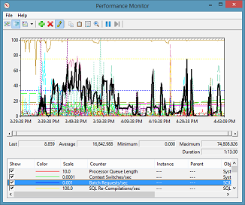
Performance Monitor Counters
Execution Statistics
SQL Errors\Errors/sec
Error types must be investigated and possibly resolved.
SQL Statistics\Batch Requests/sec
SQL Statistics\SQL Compilations/sec
A high number can be an indicator of ad hoc queries, this must be cross referenced with ad hoc plans in the plan cache.
SQL Statistics\SQL Recompilations/sec
If high determine recompilation reason with Xevent session. Usually stale statistics, Temp table usage and option WITH Recompile.
Batch Requests > 1000 indicates busy server.
Notes:
Errors/sec: It is the number of errors per second. Note that this counter has few instances. One of them is Info Errors, which might be discarded in most cases.
Batch Requests/sec: It is the number of SQL batch requests received by the server. This counter measures the number of batch requests that SQL Server receives per second and generally follows in-step to how busy your server's CPUs are. Generally, over 1,000 batch requests per second indicates a very busy SQL Server and could mean that if you are not already experiencing a CPU bottleneck, you might very likely experience one soon. Of course, this is a relative number, and the bigger your hardware, the more batch requests per second SQL Server can handle. From a network bottleneck approach, a typical 100 Mbs network card is only able to handle about 3,000 batch requests per second. If you have a server that is this busy, you might need to have two or more network cards, or go to a 1 Gbs network card.
Note: Sometimes low batch requests per second can be misleading. If there was a SQL statements per second counter, this would be a more accurate measure of the amount of SQL Server activity. For example, an application might call only a few stored procedures yet each stored procedure does a lot of work. In that case, we will see a low number for batch requests per second but each stored procedure (one batch) will execute many SQL statements that drive CPU and other resources. As a result, many counter thresholds based on the number of batch requests per second will seem to identify issues because the batch requests on such a server are unusually low for the level of activity on the server. We cannot conclude that a SQL Server is not active simply by looking at only batch requests per second. Rather, you have to do more investigation before deciding there is no load on the server. If the average number of batch requests per second is below five and other counters (such as SQL Server processor utilization) confirm the absence of significant activity, then there is not enough of a load to make any recommendations or identify issues regarding scalability.
Should this be Mbps? Also, spell out at first instance. Similarly, check if in the last sentence in this para, if it should be Gbps

Slide 42

Statistics Update
Observing Automatic statistics update
Updating Statistics by executing ALTER INDEX
Notes:
M06L03Lab01
Link to lab:
Module06: SQL Server Statistics Structure -> Lab - Statistics Update

Slide 43
Questions?

Slide 44
Knowledge Check
Does an INDEX REORG update its statistics?
What is the % of data sampled used to update statistics when ALTER INDEX … REBUILD is executed?
Is it possible to disable auto updates for a particular statistic?
What is the formula for the auto update statistics threshold in SQL Server 2106+ (compatibility 130+)?
Notes:
Q: Does reorganizing an index update its statistics?
A: No. Rebuilding an index updates its statistics.
Q: What is the % of sampled used to update statistics when ALTER INDEX … REBUILD is executed?
A: 100% / FULLSCAN
Q: Is it possible to disable auto updates for a particular statistic?
A: Yes, there are several options:
Using the option NORECOMPUTE in the CREATE STATISTICS and UPDATE STATISTICS commands.
Using the option (STATISTICS_NORECOMPUTE = ON) in the CREATE INDEX and ALTER INDEX … REBUILD commands.
Executing the stored procedure sp_autostats.
Q: What is the formula for the auto update statistics threshold in SQL Server 2106+ (compatibility 130+)?
A: RT = SQRT (1000 * #rows)

